Slide 1

TARGET FOLDER
SRNTGT023
Ostrovnoy Naval HQ, SRN
SECRET - DCS WORLD
REL TO COALITION
SECRET - DCS WORLD
REL TO COALITION

Slide 2
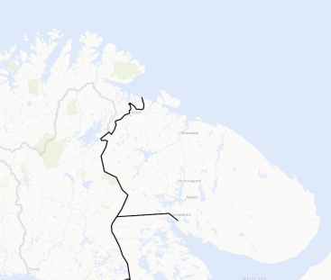
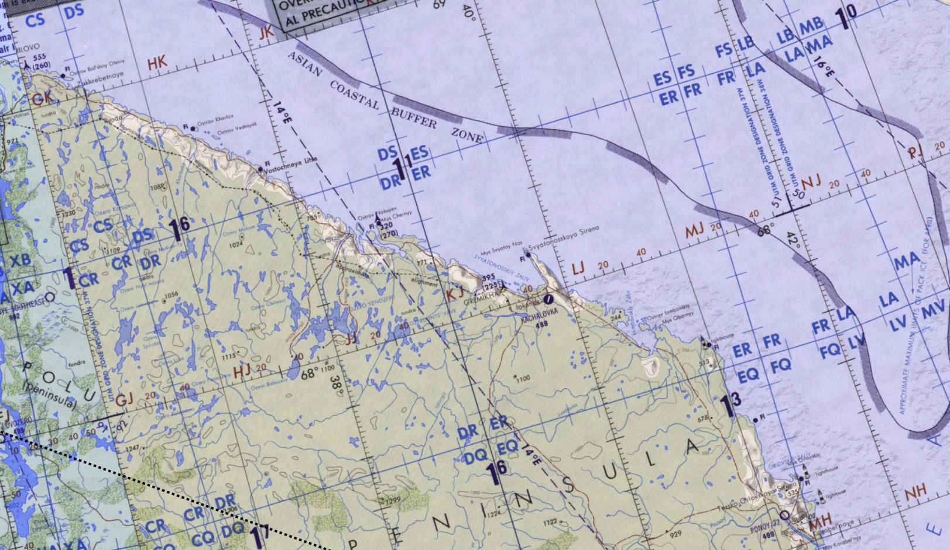
Ostrovnoy Naval HQ, SRN
OPAC CLASSIFIED REL TO CJTF-23
JOINT OPERATIONS GRAPHIC [1]
MAP
OVERVIEW
BE: SRNTGT022 CATCODE: 2
MIDB GEO: N 68 03.688 E 039 27.365
ICOD: 2011-FEB-12 DOI:2011-FEB-10
DECL ON: 2061-FEB-12
N
Ostrovnoy Naval HQ SRNTGT023
.

Slide 3
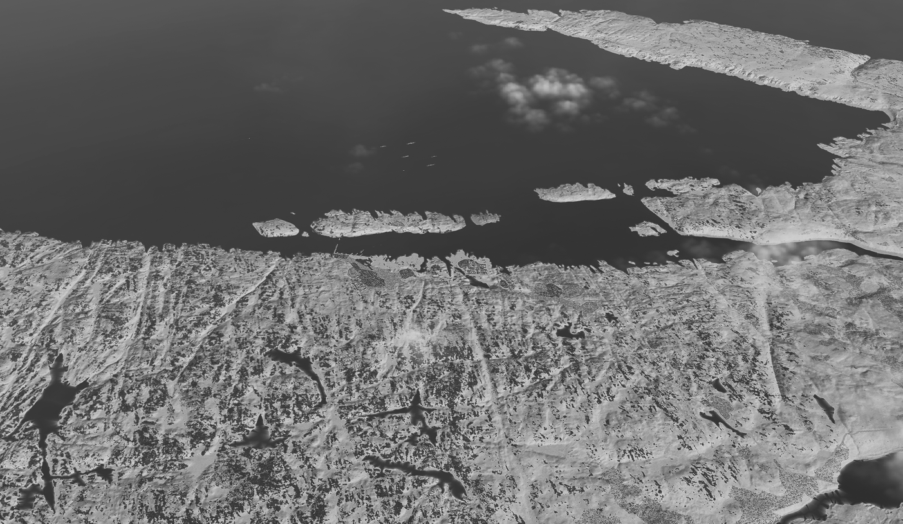
Ostrovnoy Naval HQ, SRN
OPAC CLASSIFIED REL TO CJTF-23
FACILITY OUTLINE GRAPHIC 1/1
MAP
OVERVIEW
BE: SRNTGT022 CATCODE: 2
MIDB GEO: N 68 03.688 E 039 27.365
ICOD: 2011-FEB-12 DOI:2011-FEB-10
DECL ON: 2061-FEB-12
N
Ostrovnoy Naval Station
SRNTGT022
SRNTGT024

Slide 4
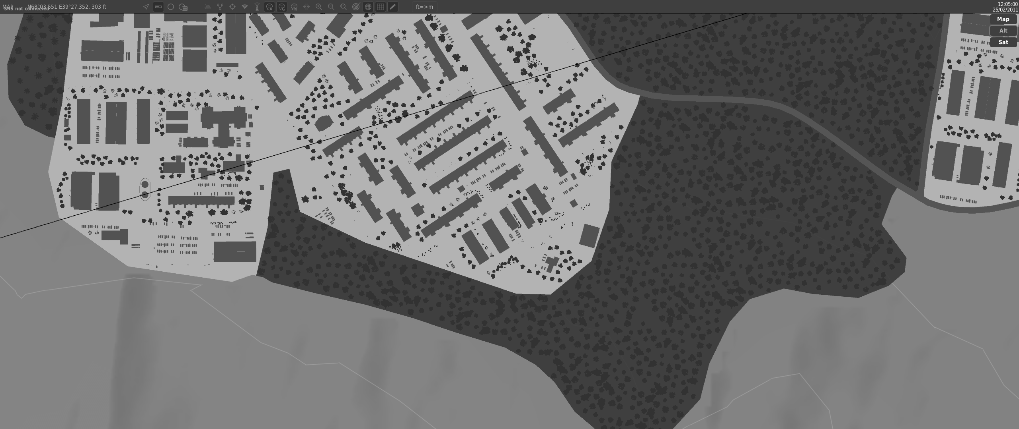
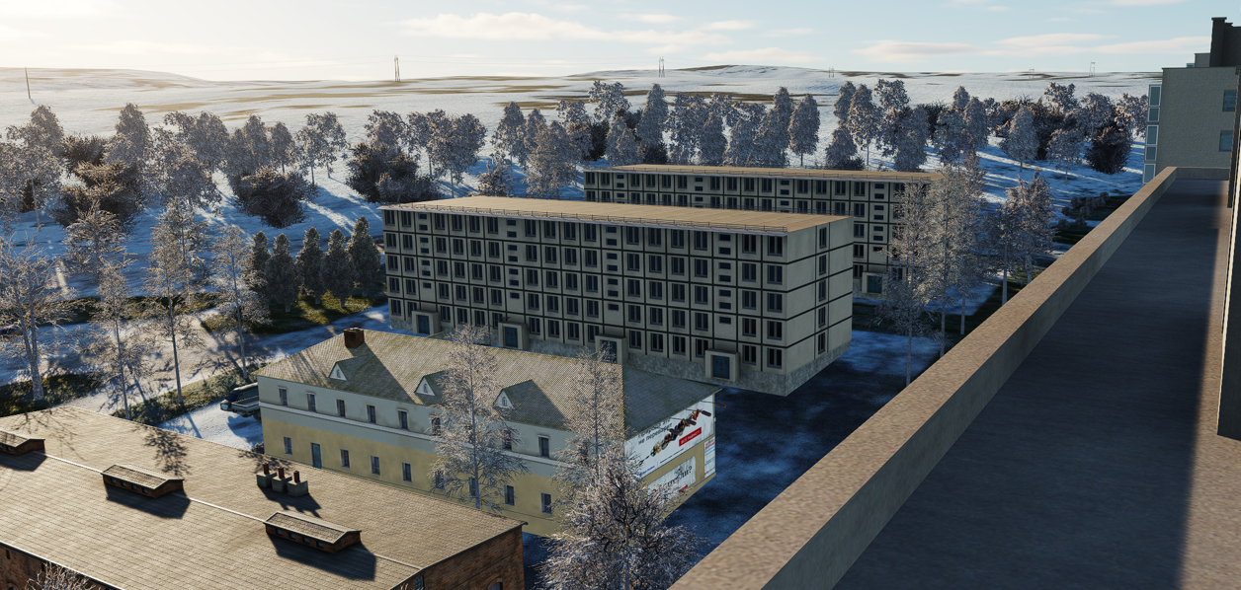
Ostrovnoy Naval HQ, SRN
OPAC CLASSIFIED REL TO CJTF-23
DESIRED POINT OF IMPACT GRAPHIC 1/1
MAP
OVERVIEW
BE: SRNTGT022 CATCODE: 2
MIDB GEO: N 68 03.688 E 039 27.365
ICOD: 2011-FEB-12 DOI:2011-FEB-10
DECL ON: 2061-FEB-12
N
X
DPI: A
OSTROVNOY NAVAL HQ
N 68 03.689 E 039 27.354 DPI MSL: 1250 FT

Slide 5
Ostrovnoy Naval HQ, SRN
OPAC CLASSIFIED REL TO CJTF-23
WEAPONEERING OPTIONS 1/1
MAP
OVERVIEW
BE: SRNTGT022 CATCODE: 2
MIDB GEO: N 68 03.688 E 039 27.365
ICOD: 2011-FEB-12 DOI:2011-FEB-10
DECL ON: 2061-FEB-12
DPI | DESCRIPTION | TLE | WARHEAD | GUIDANCE | DESIRED EFFECT | IMPACT ANGLE | FUZING
A | MS OFFICE BUILDING | CAT 3 | 4000lbs | METRIC | BLAST, FRAGMENTATION | 80-90 | 25ms

Slide 6
Ostrovnoy Naval HQ, SRN
OPAC CLASSIFIED REL TO CJTF-23
COLLATERAL DAMAGE ESTIMATION GRAPHIC 1/1
MAP
OVERVIEW
BE: SRNTGT022 CATCODE: 2
MIDB GEO: N 68 03.688 E 039 27.365
ICOD: 2011-FEB-12 DOI:2011-FEB-10
DECL ON: 2061-FEB-12
N
DPI A
CER 250M / 812FT
CDE5, FAH TO MINIMIZE LOCAL IMPACT, CIVILIAN CASUALITIES COMMAND AUTH REQUIRED

Slide 7
Ostrovnoy Naval HQ, SRN
OPAC CLASSIFIED REL TO CJTF-23
COLLATERAL DAMAGES ESTIMATION 1/1
MAP
OVERVIEW
BE: SRNTGT022 CATCODE: 2
MIDB GEO: N 68 03.688 E 039 27.365
ICOD: 2011-FEB-12 DOI:2011-FEB-10
DECL ON: 2061-FEB-12
COLLATERAL DAMAGES WITHIN A 500M RADIUS
DESCRIPTION |  | CATCODE | MIDB GEOS | LOCATION | REMARKS
CIVILIAN COMMERCIAL |  | 13 |  |  | CIVILIAN CASUALTIES, INFRASTRUCTURE
CIVILIAN RESIDENTIAL |  | 14 |  |  | CIVILIAN CASUALTIES, INFRASTRUCTURE
NO STRIKE ENTITIES WITHIN A 500M RADIUS
NSE ID | DESCRIPTION | CATCODE | MIDB GEOS | LOCATION | REMARKS

Slide 8
Ostrovnoy Naval HQ, SRN
OPAC CLASSIFIED REL TO CJTF-23
BATTLE DAMAGE ASSESSMENT GRAPHIC 1
MAP
OVERVIEW
BE: SRNTGT022 CATCODE: 2
MIDB GEO: N 68 03.688 E 039 27.365
ICOD: 2011-FEB-12 DOI:2011-FEB-10
DECL ON: 2061-FEB-12
POST-STRIKE
PRE-STRIKE
N
TARGET OBJECTIVE
DAMAGE/CHANGE ASSESSMENT
DPI:[XXXXXX]
BDA REMARK: [CLASSIFICATION] [DISSEMINATION] Assessment: Physical Damage/change, Collateral Damage, Functional Damage/change, Munitions Effectiveness, Reattack Recommendation, Additional/Collateral Effects

Slide 9

ACRONYMS
ACRONYM | MEANING | DEFINITION
BE | Basic Encyclopedia Number | Alpha/numeric code unique to an installation for incorporation within various national and tactical systems.
CATCODE | Category Code | The data Element that classifies the function and purpose of an installation or a facility.
MIDB | Modernized Integrated Database | A database comprised of information on facilities of military significance, military forces, and related equipment.
ICOD | Intelligence Cut Off Date | The date of the latest intelligence data inputted to a feature.
DOI | Date of Image | Date on which a geospatial or intelligence-related image was captured.
CE | Critical Element | An element of an entity or object that enables it to perform its primary function.
PV CHAR | Physical Vulnerability Characteristic | Standardized alphanumeric code describing the physical and structural properties of a target.
JDPI | Joint Desired Point of Impact | A unique, alphanumeric coded aimpoint identified by a three dimensional mensurated point. It represents a weapon or capability desired point of impact or penetration.
CE90 | Circular Error at 90% | 90 percent confidence level in the horizontal plane.
LE90 | Linear Error at 90% | 90 percent confidence level in the vertical dimension
MSL | Mean Sea Level | Elevation above Earth reference geoid.
AGL | Above Ground Level | Elevation above ground surface.
NCC | Nearest Collateral Concern | Closest non-targeted structure, area, or entity near a planned point of impact that may be at risk of unintended damage during a military strike.
CER | Collateral effects radius | Radius within which collateral damage might happen based on the weapon's characteristics, the target environment, and other operational factors.
CDE | Collateral damage estimate | Systematic process used in military targeting to evaluate the potential for unintended damage or harm to non-combatant entities, structures, or personnel as a result of a planned strike.
NSE | No Strike Element | Specific entities, locations, or objects that are protected from intentional targeting under the Law of Armed Conflict (LOAC) or by operational policy.

